Slide 1
Network Operations Weekly Report
Week 37

Slide 2

Summary of Activities
ACHIEVEMENTS/KEY HIGHLIGHTS
Performance Management
-Closed the week with 442 KPs defined as “commissioned”
Project Management
- 42 KPs successfully calibrated and with final dock(week 37)
Incident/Problem Management
-No major incidents reported
MAJOR ISSUES
Processes
-Duplicate Tickets in FreshService
-Close tickets twice(Freshservice and Zendesk)
Problems we are tracking
-KPs not coming online after network outage
-KP screen stuck at “Finishing Startup”
-KP Screen stuck at “Connectivity to KOKO”(4)
-KP screen not switching off at designated switch off time
HSE Incidents
-No incident(s) recorded
WORK IN PROGRESS
GPS Coordinates Verification(700KPs) - 42%

Slide 3
NOC Key Metrics
98.53%
Machine Uptime
99.15%
Serviceable Uptime
20.83%(1)
SLA Performance
98.53%
Peak Uptime
40.25%(3)
NOC vs Field Resolved incidents.
2days 10 hours
Average Resolution Time
63.52%
Proactive incident identification
34mins
Average First Response Time
0,0,71
P1, P2, P3
159
Total tickets attended to (new and resolved)

Slide 4
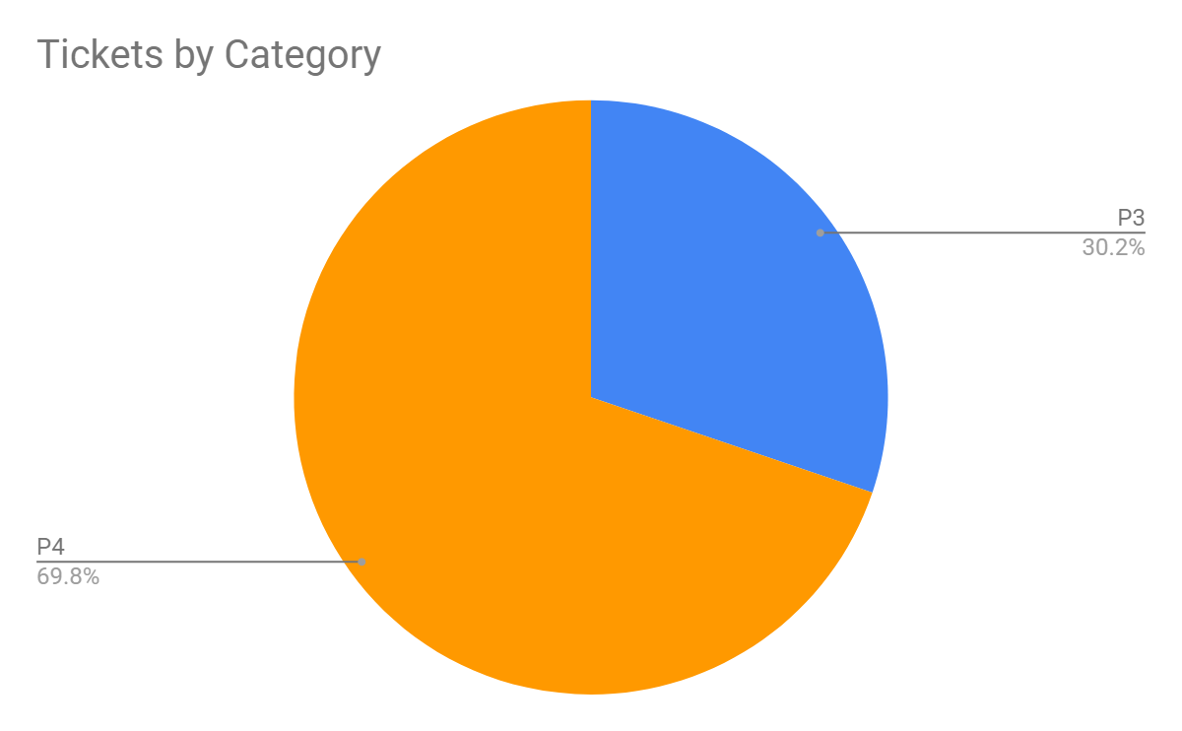
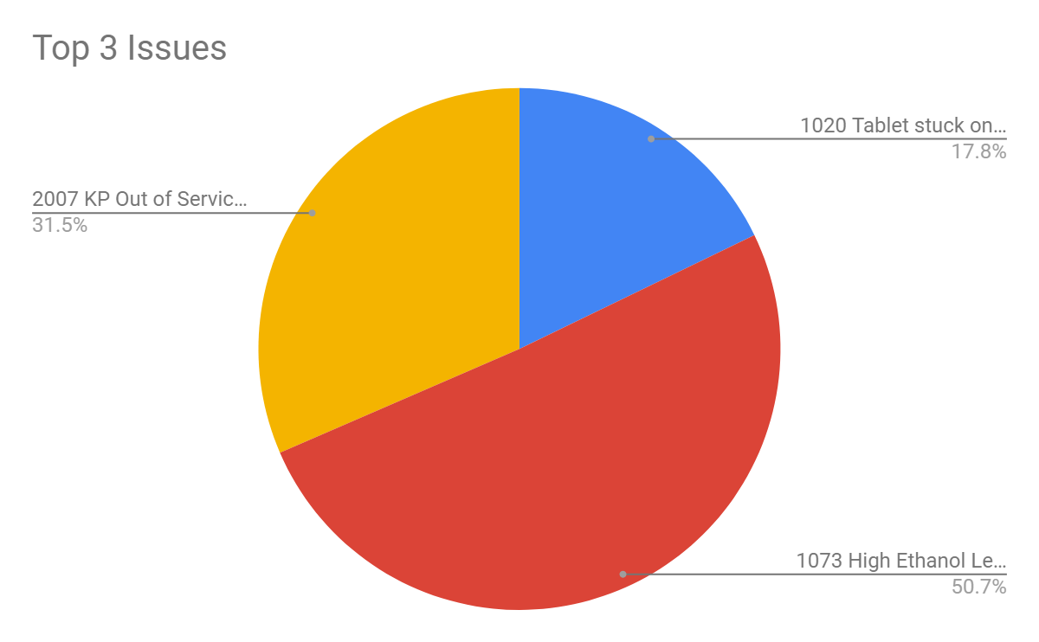
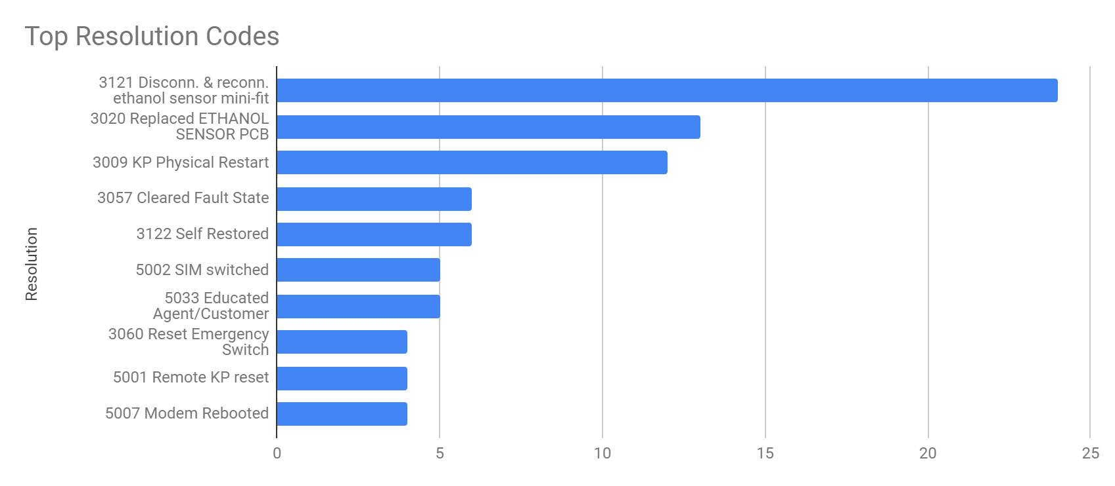
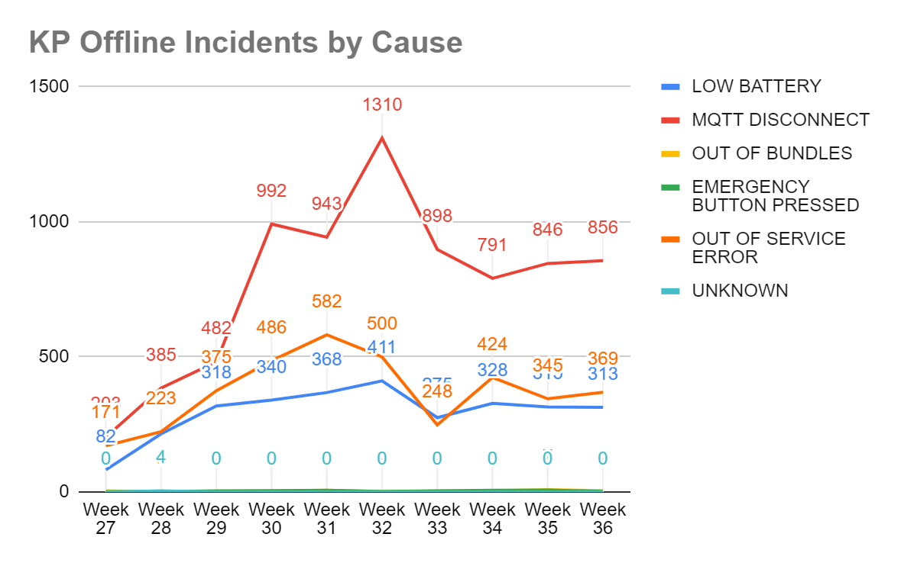
Incident and Problem Analysis

Slide 5
Field Operations Key Metrics
103 (3)
12(1)
70(1)
Total number of visits
Average number of field activities per day
23% (1)
SLA Performance
1 Day 20 Mins
Average Resolution Time
0%
Scheduled vs unscheduled maintenance
30% (1)
Punctuality
25 Mins
Average task time
22 (2)
No. of revisits
1322 KM
Total distance covered
4.25Hrs
Average Transit Time per Day

Slide 6
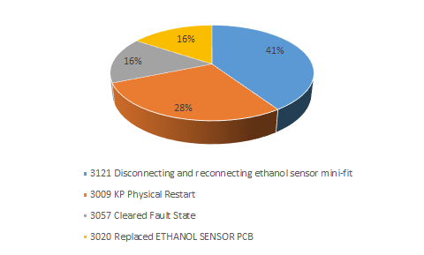
Field Operations Key Metrics
Top Repair Codes
Top 5 Parts Replaced
Parts Replaced | Task Count
Ethanol sensor PCB | 5
SMV Docks | 3
Dispense Fuel MBV | 2
Tank Temp sensor Probe | 1
UPS | 1

Slide 7
Notes on metrics
SLA performance, punctuality and number of visits per day was impacted by delays related to operational issues related to movement of vehicles.
Revisits were attributed to High Ethanol Alerts and Part of rework (Install of ID Plate and Type Approval).
Investigation of high ethanol levels & KPs stuck at “checking connectivity to KOKO” which required field intervention outstripped all other incident categories including those that could be resolved by NOC.
The “checking connectivity to KOKO” fault is still pending with the Technology Reliability team; Five additional occurrences were reported in the past week.

Slide 8
team_noc@kokonetworks.com

